Slide 1


Subject Code: SITA1502
Subject Name: CUSTOMER INTERFACE DESIGN AND DEVELOPMENT
Faculty Name: Dr.R.Jeberson Retna Raj

Slide 2
UNIT4 ANGULAR JS & JQUERY
UNIT4 ANGULAR JS & JQUERY
Angular JS Expression – Modules – Directives – Data Binding – Controllers – Scopes – Filters – Services – Tables – Events – Form – Validation. Query Syntax – Selects – Events – jQuery Effects – jQuery – jQuery HTML – jQuery Traversing.

Slide 3
What is Angular Js?
It is an open-source and front-end web development framework with great features or support.
Google's Angular team first launched it in 2010.
It is a framework that is continually developing and expanding to include better methods for creating web applications.
It develops applications primarily using the model view controller (MVC) concept and supports both data binding features and dependency injection.

Slide 4
Differences between the JavaScript and Angular JS
Features | JavaScript | Angular JS
Definition | It is an object-oriented scripted language that is used to develop mobile and dynamic web applications. | It an open-source framework used to develop dynamic web and large single-page web applications.
Developed | Netscape Communications developed it in 1995. | Google mainly developed it in 2010.
Syntax | Its syntax is much complex than Angular JS. | Its syntax is simple and easy.
Programmed | Its interpreters are written in the C and C++ languages. | It is written in the JavaScript language.
Filters | It doesn't support the filters. | It does support filters.
Learnability | It isn't very easy to learn. | It is easy to learn if anyone knows the basic knowledge of JavaScript.
Concept | It is based on the dynamic typing concept. | Angular JS is based on the concept of the model view controller to build the applications.
Dependency injection | It doesn't support the dependency injection. | It supports both data binding and dependency injection.

Slide 5
AngularJS
AngularJS is a very powerful JavaScript Framework. It is used in Single Page Application (SPA) projects.
It extends HTML DOM with additional attributes and makes it more responsive to user actions. AngularJS is open source,
provides developers an options to write client side applications using JavaScript in a clean Model View Controller (MVC) way.
Applications written in AngularJS are cross-browser compliant. AngularJS automatically handles JavaScript code suitable for each browser.
AngularJS is open source, completely free, and used by thousands of developers around the world. It is licensed under the Apache license version 2.0.

Slide 6
AngularJS
AngularJS is a JavaScript framework. It can be added to an HTML page with a <script> tag.
AngularJS extends HTML attributes with Directives, and binds data to HTML with Expressions.
AngularJS is a JavaScript Framework
AngularJS is a JavaScript framework written in JavaScript.
AngularJS is distributed as a JavaScript file, and can be added to a web page with a script tag:
<script src="https://ajax.googleapis.com/ajax/libs/angularjs/1.6.9/angular.min.js"></script>

Slide 7
Angular JS features
There are various features of angular JS. Some of them are as follows:
Time-saving: AngularJS allows us to work with modules that help us to reuse them, saving time and code.
Easy to work: It is easy to work with Angular JS because it uses JavaScript, HTML, and CSS languages.
Ready to use a template: AngularJS is mostly plain HTML, and it mostly uses the plain HTML template, which it passes to the DOM and then to the AngularJS compiler. It passes through the templates, and then they're ready to use.

Slide 8
8 Benefits of Using AngularJS for Web App Development
Popular websites and applications which use AngularJS are Paypal, Udemy, Snapchat, Amazon, Netflix and Gmail.
Easy to Learn:
knowledge of HTML, JavaScript and CSS can easily learn AngularJS.
It has a Two-Way Binding Feature:
immediate synchronization between the view and the model
Supports SPA features:
dynamically replacing the existing web page with new Web server data
Has a Declarative UI:
Templates include AngularJS specific elements and attributes such as filters, directives such as ng-app, ng-repeat, ng-model, form controls and so on.

Slide 9
8 Benefits of Using AngularJS for Web App Development
Supported by Google:
The language has gained credibility due to Google’s backing
Allows for Optimal Web Application Management:
Earlier developers manually string three different components: Model, View and Control (MVC). Now AngularJS saves time as this framework automatically strings the code together.
It is a Powerful Framework:
multiple features such as MVC pattern, directives, and dependency injection. This allows developers to expand the HTML syntax and build client-side applications.
Real-Time Testing:
AngularJS allows for both end-to-end and unit testing

Slide 10
AngularJS Extends HTML
AngularJS extends HTML with ng-directives.
The ng-app directive defines an AngularJS application.
The ng-model directive binds the value of HTML controls (input, select, textarea) to application data.
The ng-bind directive binds application data to the HTML view.
<!DOCTYPE html> <html> <script src="https://ajax.googleapis.com/ajax/libs/angularjs/1.6.9/angular.min.js"></script> <body> <div ng-app=""> <p>Name: <input type="text" ng-model="name"></p> <p ng-bind="name"></p> </div> </body> </html>

Slide 11
AngularJS Extends HTML
AngularJS starts automatically when the web page has loaded.
The ng-app directive tells AngularJS that the <div> element is the "owner" of an AngularJS application.
The ng-model directive binds the value of the input field to the application variable name.
The ng-bind directive binds the content of the <p> element to the application variable name.

Slide 12
AngularJS Directives
AngularJS directives are HTML attributes with an ng prefix.
The ng-init directive initializes AngularJS application variables.
You can use data-ng-, instead of ng-, if you want to make your page HTML valid.
<div ng-app="" ng-init="firstName='John'"> <p>The name is <span ng-bind="firstName"></span></p> </div>
<div data-ng-app="" data-ng-init="firstName='John'"> <p>The name is <span data-ng-bind="firstName"></span></p> </div>

Slide 13
AngularJS Expressions
AngularJS expressions are written inside double braces: {{ expression }}.
AngularJS will "output" data exactly where the expression is written:
<html> <script src="https://ajax.googleapis.com/ajax/libs/angularjs/1.6.9/angular.min.js"></script> <body> <div ng-app=""> <p>My first expression: {{ 5 + 5 }}</p> </div> </body> </html>

Slide 14
AngularJS Expressions
AngularJS expressions bind AngularJS data to HTML the same way as the ng-bind directive.
<!DOCTYPE html> <html> <script src="https://ajax.googleapis.com/ajax/libs/angularjs/1.6.9/angular.min.js"></script> <body> <div ng-app=""> <p>Name: <input type="text" ng-model="name"></p> <p>{{name}}</p> </div> </body> </html>

Slide 15
AngularJS Applications
AngularJS modules define AngularJS applications.
AngularJS controllers control AngularJS applications.
The ng-app directive defines the application, the ng-controller directive defines the controller.
<html>
<script src="https://ajax.googleapis.com/ajax/libs/angularjs/1.6.9/angular.min.js"></script>
<body>
<p>Try to change the names.</p>
<div ng-app="myApp" ng-controller="myCtrl">
First Name: <input type="text" ng-model="firstName"><br>
Last Name: <input type="text" ng-model="lastName"><br>
<br>
Full Name: {{firstName + " " + lastName}}
</div>
<script>
var app = angular.module('myApp', []);
app.controller('myCtrl', function($scope) {
$scope.firstName= "John";
$scope.lastName= "Doe";
});
</script>
</body>
</html>

Slide 16
Blockchain
AngularJS modules define applications:
AngularJS Module
AngularJS controllers control applications:
AngularJS Controller
var app = angular.module('myApp', []);
app.controller('myCtrl', function($scope) { $scope.firstName= "John"; $scope.lastName= "Doe"; });

Slide 17
AngularJS Expressions
AngularJS expressions can be written inside double braces: {{ expression }}.
AngularJS expressions can also be written inside a directive: ng-bind="expression".
AngularJS will resolve the expression, and return the result exactly where the expression is written.
AngularJS expressions are much like JavaScript expressions: They can contain literals, operators, and variables.
Example {{ 5 + 5 }} or {{ firstName + " " + lastName }}
<html> <script src="https://ajax.googleapis.com/ajax/libs/angularjs/1.6.9/angular.min.js"></script> <body> <div ng-app=""> <p>My first expression: {{ 5 + 5 }}</p> </div> </body> </html>

Slide 18
AngularJS Expressions
If you remove the ng-app directive, HTML will display the expression as it is, without solving it:
<html> <script src="https://ajax.googleapis.com/ajax/libs/angularjs/1.6.9/angular.min.js"></script> <body> <div> <p>My first expression: {{ 5 + 5 }}</p> </div> </body> </html>

Slide 19
AngularJS Expressions
You can write expressions wherever you like, AngularJS will simply resolve the expression and return the result.
Example: Let AngularJS change the value of CSS properties.
Change the color of the input box below, by changing its value:
<div ng-app="" ng-init="myCol='lightblue'"> <input style="background-color:{{myCol}}" ng-model="myCol"> </div>

Slide 20
AngularJS Numbers
AngularJS numbers are like JavaScript numbers:
Same example using ng-bind:
<div ng-app="" ng-init="quantity=1;cost=5"> <p>Total in dollar: {{ quantity * cost }}</p> </div>
<div ng-app="" ng-init="quantity=1;cost=5"> <p>Total in dollar: <span ng-bind="quantity * cost"></span></p> </div>

Slide 21
AngularJS Strings
AngularJS strings are like JavaScript strings:
Same example using ng-bind:
<div ng-app="" ng-init="firstName='John';lastName='Doe'"> <p>The name is {{ firstName + " " + lastName }}</p> </div>

Slide 22
AngularJS Numbers
AngularJS numbers are like JavaScript numbers:
<div ng-app="" ng-init="firstName='John';lastName='Doe'"> <p>The name is <span ng-bind="firstName + ' ' + lastName"></span></p> </div>

Slide 23
AngularJS Objects
AngularJS objects are like JavaScript objects:
Same example using ng-bind:
<div ng-app="" ng-init="person={firstName:'John',lastName:'Doe'}"> <p>The name is {{ person.lastName }}</p> </div>
<div ng-app="" ng-init="person={firstName:'John',lastName:'Doe'}"> <p>The name is <span ng-bind="person.lastName"></span></p> </div>

Slide 24
AngularJS Arrays
AngularJS arrays are like JavaScript arrays:
Same example using ng-bind:
<div ng-app="" ng-init="points=[1,15,19,2,40]"> <p>The third result is {{ points[2] }}</p> </div>
<div ng-app="" ng-init="points=[1,15,19,2,40]"> <p>The third result is <span ng-bind="points[2]"></span></p> </div>

Slide 25
AngularJS Expressions vs. JavaScript Expressions
Like JavaScript expressions, AngularJS expressions can contain literals, operators, and variables.
Unlike JavaScript expressions, AngularJS expressions can be written inside HTML.
AngularJS expressions do not support conditionals, loops, and exceptions, while JavaScript expressions do.
AngularJS expressions support filters, while JavaScript expressions do not.

Slide 26
AngularJS application
AngularJS application to consist of:
View, which is the HTML.
Model, which is the data available for the current view.
Controller, which is the JavaScript function that makes/changes/removes/controls the data.

Slide 27
AngularJS Directives
Most of the directives in AngularJS are starting with ng- where ng stands for Angular. AngularJS includes various built-in directives.

Slide 28
AngularJS Directives
The following table lists the important built-in AngularJS directives.
Directive | Description
ng-app | Auto bootstrap AngularJS application.
ng-init | Initializes AngularJS variables
ng-model | Binds HTML control's value to a property on the $scope object.
ng-controller | Attaches the controller of MVC to the view.
ng-bind | Replaces the value of HTML control with the value of specified AngularJS expression.
ng-repeat | Repeats HTML template once per each item in the specified collection.
ng-show | Display HTML element based on the value of the specified expression.
ng-readonly | Makes HTML element read-only based on the value of the specified expression.
ng-disabled | Sets the disable attribute on the HTML element if specified expression evaluates to true.
ng-if | Removes or recreates HTML element based on an expression.
ng-click | Specifies custom behavior when an element is clicked.

Slide 29
AngularJS Directives
ng-app
The ng-app directive initializes AngularJS and makes the specified element a root element of the application.

Slide 30
AngularJS Directives
ng-init
The ng-init directive can be used to initialize variables in AngularJS application.
The following example demonstrates ng-init directive that initializes variable of string, number, array, and object.
<!DOCTYPE html>
<html >
<head>
<script src=" https://ajax.googleapis.com/ajax/libs/angularjs/1.6.9/angular.min.js "></script>
</head>
<body >
<div ng-app ng-init="greet='Hello World!'; amount= 100; myArr = [100, 200]; person = { firstName:'Steve', lastName :'Jobs'}">
{{amount}} <br />
{{myArr[1]}} <br />
{{person.firstName}}
</div>
</body>
</html>

Slide 31
ng-model
ng-model
The ng-model directive is used for two-way data binding in AngularJS. It binds <input>, <select> or <textarea> elements to a specified property on the $scope object. So, the value of the element will be the value of a property and vica-versa.
<!DOCTYPE html>
<html >
<head>
<script src=" https://ajax.googleapis.com/ajax/libs/angularjs/1.6.9/angular.min.js "></script>
</head>
<body ng-app>
<input type="text" ng-model="name" />
<div>
Hello {{name}}
</div>
</body>
</html>

Slide 32
ng-bind
ng-bind
The ng-bind directive binds the model property declared via $scope or ng-model directive or the result of an expression to the HTML element. It also updates an element if the value of an expression changes.
<!DOCTYPE html>
<html >
<head>
<script src=" https://ajax.googleapis.com/ajax/libs/angularjs/1.6.9/angular.min.js "></script>
</head>
<body ng-app="">
<div>
5 + 5 = <span ng-bind="5 + 5"></span> <br />
Enter your name: <input type="text" ng-model="name" /><br />
Hello <span ng-bind="name"></span>
</div>
</body>
</html>

Slide 33
ng-repeat
ng-repeat
The ng-repeat directive repeats HTML once per each item in the specified array collection.

Slide 34
ng-repeat
<!DOCTYPE html>
<html>
<head>
<script src=" https://ajax.googleapis.com/ajax/libs/angularjs/1.6.9/angular.min.js "></script>
<style>
div {
border: 1px solid green;
width: 100%;
height: 50px;
display: block;
margin-bottom: 10px;
text-align:center;
background-color:yellow;
}
</style>
</head>
<body ng-app="" ng-init="students=['Bill','Steve','Ram']">
<ol>
<li ng-repeat="name in students">
{{name}}
</li>
</ol>
<div ng-repeat="name in students">
{{name}}
</div>
</body>
</html>

Slide 35
ng-if,ng-readonly,ng-disabled
ng-if
The ng-if directive creates or removes an HTML element based on the Boolean value returned from the specified expression. If an expression returns true then it recreates an element otherwise removes an element from the HTML document.
ng-readonly
The ng-readonly directive makes an HTML element read-only, based on the Boolean value returned from the specified expression. If an expression returns true then the element will become read-only, otherwise not.
ng-disabled
The ng-disabled directive disables an HTML element, based on the Boolean value returned from the specified expression. If an expression returns true the element will be disabled, otherwise not.

Slide 36
<!DOCTYPE html>
<html>
<head>
<script src=" https://ajax.googleapis.com/ajax/libs/angularjs/1.6.9/angular.min.js "></script>
<style>
div {
width: 100%;
height: 50px;
display: block;
margin: 15px 0 0 10px;
}
</style>
</head>
<body ng-app ng-init="checked=true" >
Click Me: <input type="checkbox" ng-model="checked" /> <br />
<div>
New: <input ng-if="checked" type="text" />
</div>
<div>
Read-only: <input ng-readonly="checked" type="text" value="This is read-only." />
</div>
<div>
Disabled: <input ng-disabled="checked" type="text" value="This is disabled." />
</div>
</body>
</html>

Slide 37
Directive Syntax
Directive Syntax
AngularJS directives can be applied to DOM elements in many ways. It is not mandatory to use ng- syntax only.
Directive can start with x- or data-, for example ng-model directive can be written as data-ng-model or x-ng-model.
Also, the - in the directive can be replaced with : or _ or both. For example, ng-model can be written as ng_model or ng:model. It can also be a mix with data- or x-.
The following example demonstrates all the rules of a directive syntax.

Slide 38
<!DOCTYPE html>
<html >
<head>
<script src=" https://ajax.googleapis.com/ajax/libs/angularjs/1.6.9/angular.min.js "></script>
</head>
<body ng-app>
Enter Name: <input type="text" ng-model="name" /> <br />
data-ng-bind: <span data-ng-bind="name"></span><br />
data-ng:bind: <span data-ng:bind="name"></span><br />
data:ng:bind: <span data:ng:bind="name"></span><br />
x:ng:bind: <span x:ng:bind="name"></span><br />
ng:bind: <span ng:bind="name"></span><br />
x-ng-bind: <span x-ng-bind="name"></span><br />
x_ng_bind: <span x_ng_bind="name"></span><br />
ng_bind: <span ng_bind="name"></span>
</body>
</html>

Slide 39
AngularJS Expression
AngularJS expression is like JavaScript expression surrounded with braces - {{ expression }}. AngularJS evaluates the specified expression and binds the result data to HTML.
AngularJS expression can contain literals, operators and variables like JavaScript expression. For example, an expression {{2/2}} will produce the result 1 and will be bound to HTML.

Slide 40
AngularJS Expression
<!DOCTYPE html>
<html >
<head>
<script src=" https://ajax.googleapis.com/ajax/libs/angularjs/1.6.9/angular.min.js "></script>
</head>
<body >
<h1>AngularJS Expression Demo:</h1>
<div ng-app>
2 + 2 = {{2 + 2}} <br />
2 - 2 = {{2 - 2}} <br />
2 * 2 = {{2 * 2}} <br />
2 / 2 = {{2 / 2}}
</div>
</body>
</html>

Slide 41
AngularJS expression is like JavaScript code expression except for the following differences:
AngularJS expression cannot contain conditions, loops, exceptions or regular expressions e.g. if-else, ternary, for loop, while loop etc.
AngularJS expression cannot declare functions.
AngularJS expression cannot contain comma or void.
AngularJS expression cannot contain return keyword.
AngularJS expression contains literals of any data type.

Slide 42
<html >
<head>
<script src=" https://ajax.googleapis.com/ajax/libs/angularjs/1.6.9/angular.min.js "></script>
</head>
<body >
<h1>AngularJS Expression Demo:</h1>
<div ng-app>
{{"Hello World"}}<br />
{{100}}<br />
{{true}}<br />
{{10.2}}
</div>
</body>
</html>

Slide 43
AngularJS expression can contain arithmetic operators which will produce the result based on the type of operands, similar to JavaScript:
<!DOCTYPE html>
<html >
<head>
<script src=" https://ajax.googleapis.com/ajax/libs/angularjs/1.6.9/angular.min.js "></script>
</head>
<body >
<div ng-app>
{{"Hello" + " World"}}<br />
{{100 + 100 }}<br />
{{true + false}}<br />
{{10.2 + 10.2}}<br />
</div>
</body>
</html>

Slide 44
AngularJS expression can contain variables declared via ng-init directive. The ng-init directive is used to declare AngularJS application variables of any data type.
<!DOCTYPE html>
<html >
<head>
<script src=" https://ajax.googleapis.com/ajax/libs/angularjs/1.6.9/angular.min.js "></script>
</head>
<body >
<div ng-app ng-init="greet='Hello World!'; amount= 10000;rateOfInterest = 10.5; duration=10; myArr = [100, 200]; person = { firstName:'Steve', lastName :'Jobs'}">
{{ (amount * rateOfInterest * duration)/100 }}<br />
{{myArr[1]}} <br />
{{person.firstName + " " + person.lastName}}
</div>
</body>
</html>

Slide 45
AngularJS Controller
The controller in AngularJS is a JavaScript function that maintains the application data and behavior using $scope object.
The $scope object is a glue between the controller and HTML.
The ng-controller directive is used to specify a controller in HTML element, which will add behavior or maintain the data in that HTML element and its child elements.

Slide 46
AngularJS Controller
The controller
<html >
<head>
<title>AngualrJS Controller</title>
<script src=" https://ajax.googleapis.com/ajax/libs/angularjs/1.6.9/angular.min.js "></script>
</head>
<body ng-app="myNgApp">
<div ng-controller="myController">
{{message}}
</div>
<script>
var ngApp = angular.module('myNgApp', []);
ngApp.controller('myController', function ($scope) {
$scope.message = "Hello World!";
});
</script>
</body>
</html>

Slide 47
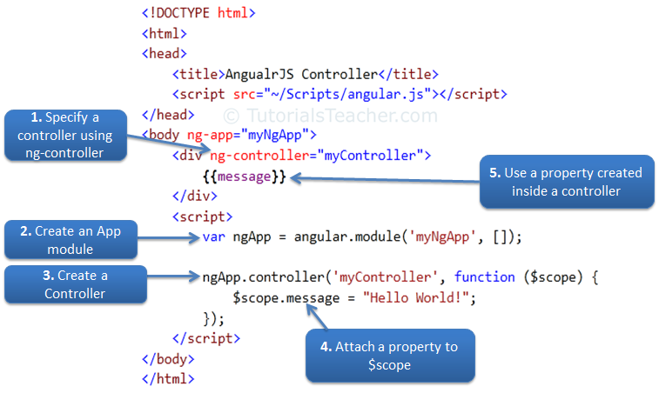
AngularJS Controller
Steps to create an AngularJS Controller

Slide 48
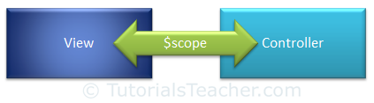
Scope in AngularJS
The $scope in an AngularJS is a built-in object, which contains application data and methods.
You can create properties to a $scope object inside a controller function and assign a value or function to it.
The $scope is glue between a controller and view (HTML). It transfers data from the controller to view and vice-versa.

Slide 49
AngularJS Controller
$rootScope
An AngularJS application has a single $rootScope. All the other $scope objects are child objects.
The properties and methods attached to $rootScope will be available to all the controllers.

Slide 50
AngularJS Filters
AngularJS Filters allow us to format the data to display on UI without changing original format.
Filters can be used with an expression or directives using pipe | sign.
{{expression | filterName:parameter }}
Angular includes various filters to format data of different data types. The following table lists important filters.

Slide 51
AngularJS Filters
Filter Name | Description
Number | Formats a numeric data as text with comma and fraction.
Currency | Formats numeric data into specified currency format and fraction.
Date | Formats date to string in specified format.
Uppercase | Converts string to upper case.
Lowercase | Converts string to lower case.
Filter | Filters an array based on specified criteria and returns new array.
orderBy | Sorts an array based on specified predicate expression.
Json | Converts JavaScript object into JSON string
limitTo | Returns new array containing specified number of elements from an existing array.

Slide 52
AngularJS Filters
Number Filter
A number filter formats numeric data as text with comma and specified fraction size.
{{ number_expression | number:fractionSize}}
If a specified expression does not return a valid number then number filter displays an empty string.

Slide 53
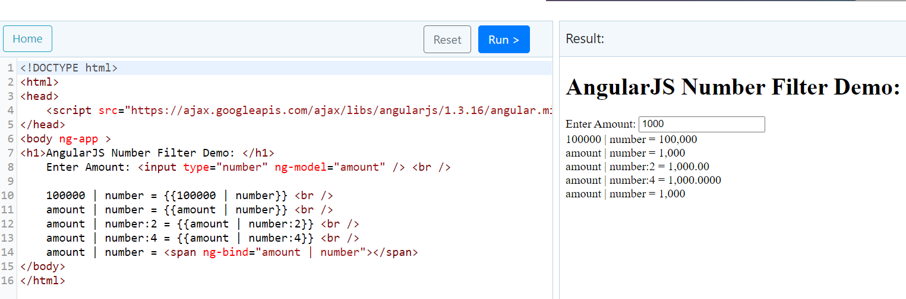
AngularJS Filters

Slide 54
AngularJS Filters
Currency Filter
The currency filter formats a number value as a currency. When no currency symbol is provided, default symbol for current locale is used.
{{ expression | currency : 'currency_symbol' : 'fraction'}}

Slide 55
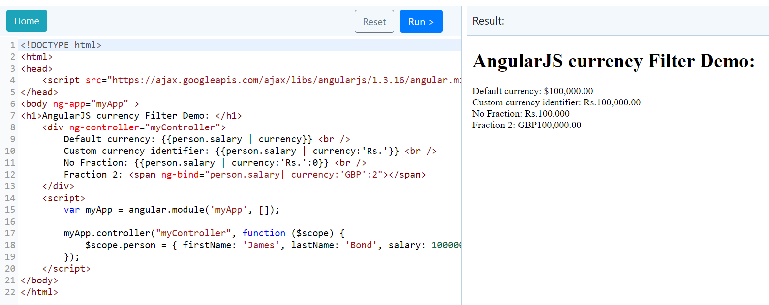
AngularJS Filters
AngularJS

Slide 56
AngularJS Filters
Date filter
Formats date to string based on the specified format.
{{ date_expression | date : 'format'}}

Slide 57
AngularJS Filters
AngularJS

Slide 58
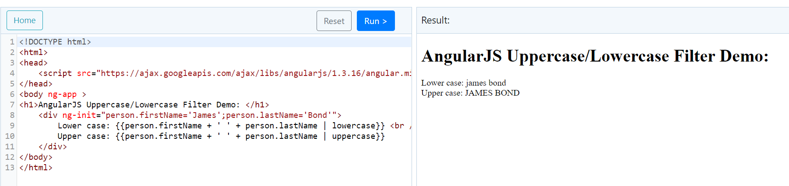
AngularJS Filters
Uppercase/lowercase filter
The uppercase filter converts the string to upper case and lowercase filter converts the string to lower case.

Slide 59
AngularJS Filters
orderBy filter
The orderBy filter sorts an array based on specified expression predicate.
{{ expression | orderBy : predicate_expression : reverse}}

Slide 60
Validation in AngularJS
AngularJS includes the following validation directives.
Directive | Description
ng-required | Sets required attribute on an input field.
ng-minlength | Sets minlength attribute on an input field.
ng-maxlength | Sets maxlength attribute on an input field. Setting the attribute to a negative or non-numeric value, allows view values of any length.
ng-pattern | Sets pattern validation error key if the ngModel value does not match the specified RegEx expression.

Slide 61
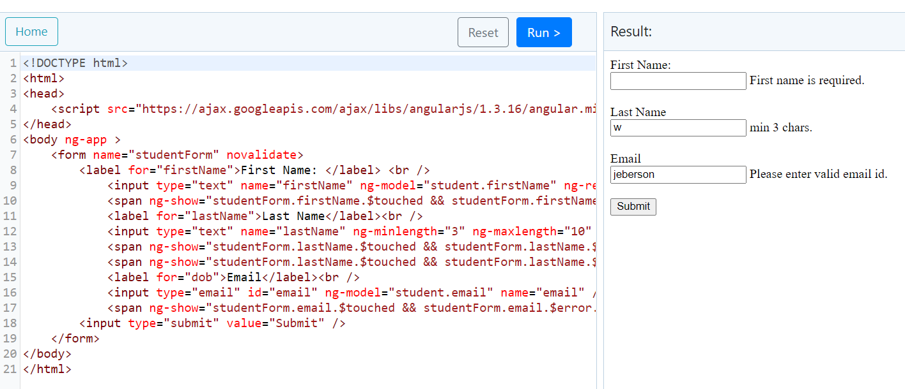
AngularJS Filters

Slide 62
AngularJS Filters
<html>
<head>
<script src="https://ajax.googleapis.com/ajax/libs/angularjs/1.3.16/angular.min.js"></script>
</head>
<body ng-app >
<form name="studentForm" novalidate>
<label for="firstName">First Name: </label> <br />
<input type="text" name="firstName" ng-model="student.firstName" ng-required="true" />
<span ng-show="studentForm.firstName.$touched && studentForm.firstName.$error.required">First name is required.</span><br /><br />
<label for="lastName">Last Name</label><br />
<input type="text" name="lastName" ng-minlength="3" ng-maxlength="10" ng-model="student.lastName" />
<span ng-show="studentForm.lastName.$touched && studentForm.lastName.$error.minlength">min 3 chars.</span>
<span ng-show="studentForm.lastName.$touched && studentForm.lastName.$error.maxlength">Max 10 chars.</span><br /><br />
<label for="dob">Email</label><br />
<input type="email" id="email" ng-model="student.email" name="email" />
<span ng-show="studentForm.email.$touched && studentForm.email.$error.email">Please enter valid email id.</span><br /><br />
<input type="submit" value="Submit" />
</form>
</body>
</html>

Slide 63
AngularJS Events
AngularJS Events
AngularJS includes certain directives which can be used to provide custom behavior on various DOM events, such as click, dblclick, mouseenter etc.
The following table lists AngularJS event directives.
Event Directive
ng-blur
ng-change
ng-click
ng-dblclick
ng-focus
ng-keydown
ng-keyup
ng-keypress
ng-mousedown
ng-mouseenter
ng-mouseleave
ng-mousemove
ng-mouseover
ng-mouseup

Slide 64
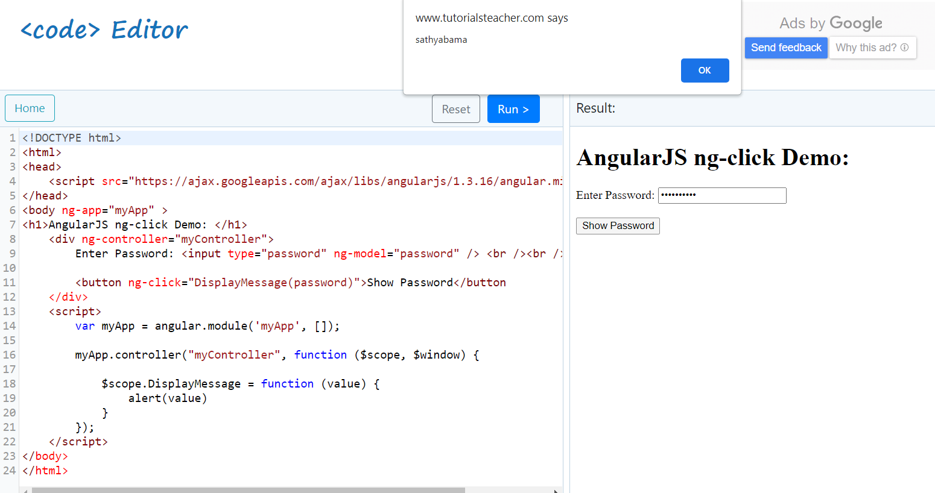
AngularJS Events
ng-click
The ng-click directive is used to provide event handler for click event.

Slide 65
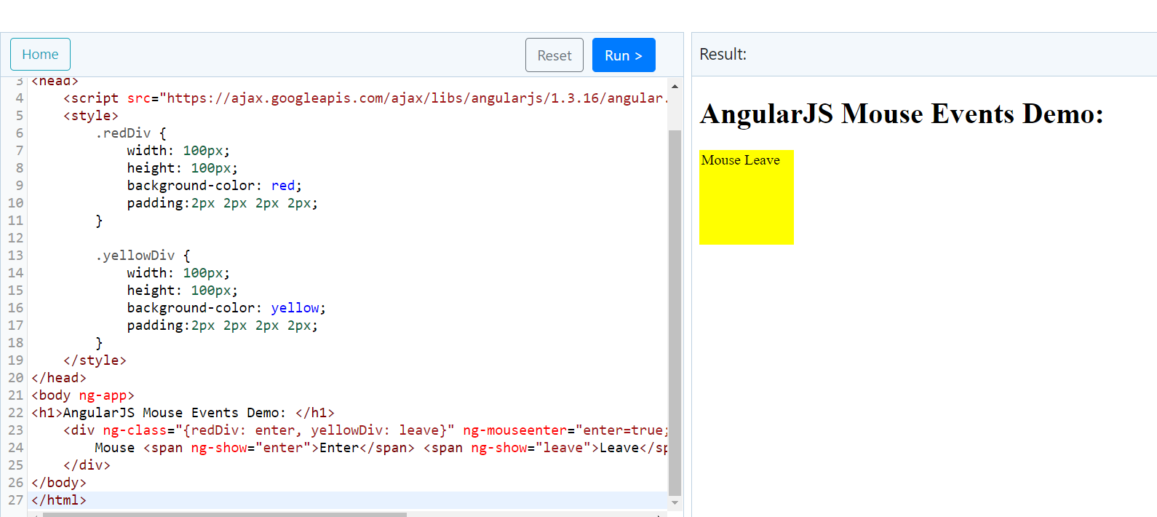
AngularJS Events
Mouse Events
The following example demonstrates important mouse event directives - ng-mouseenter and ng-mouseleave.

Slide 66
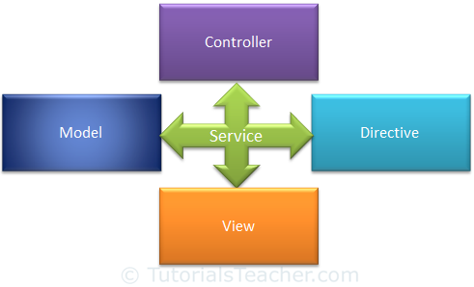
AngularJS Service
AngularJS includes services for different purposes. For example, $http service can be used to send an AJAX request to the remote server.
AngularJS also allows you to create custom service for your application.

Slide 67
$anchorScroll $exceptionHandler $interval $rootScope
$animate $filter $locale $sceDelegate
$cacheFactory $httpParamSerializer $location $sce
$templateCache $httpParamSerializerJQLike $log $templateRequest
$compile $http $parse $timeout
$controller $httpBackend $q $window
$document $interpolate $rootElement

